Slide 1
Radiometric Partial Discharge Condition Monitoring for High Voltage Electricity Substations
Pavlos Lazaridis & Ian Glover
Department of Engineering & Technology
University of Huddersfield
Huddersfield, UK
p.lazaridis@hud.ac.uk

Slide 2
Collaborating institutions
I. A. Glover ^{1 ,} Yong Zhang ^{1,} B. Saeed ¹, D. W. Upton ¹, U. Khan ¹, A. Jaber ¹, H. Mohamed ¹, K. Mistry ¹, P. J. Mather ¹, P. Lazaridis^{1,} M. F. Q. Vieira ², R. Atkinson ³, C. Tachtatzis ³ , E. Iorkyase ³, M. Judd ⁴, José Mauricio Neto ² and José Sergio Neto ².
¹Department of Engineering and Technology, University of Huddersfield, Huddersfield, UK
²Departamento de Engenharia Eletrica, Universidade Federal de Campina Grande, Brazil
³Department of Electronic and Electrical Engineering, University of Strathclyde, Glasgow, UK
⁴High Frequency Diagnostics and Engineering Ltd., Glasgow G2 6HJ, UK

Slide 3
Structure
Motivation
Origin of partial discharge
A free-space radiometric system
PD detection with SDR
Conclusions

Slide 4
Motivation
Ageing power systems infrastructure
Reason for unplanned outages
Cost of outages
PD associated with compromised insulation
Monitoring of PD to predict failures

Slide 5
Partial discharge
+V
Dielectric
ε_{d}
ε_{d} > ε_{v}
ε_{v}
ε_{v} < ε_{d}
Field strength is void is greater than that in insulation
Insulation strength of void is less than that of insulation
PD characterized by series of discrete current pulses

Slide 6
Why worry about condition monitoring?
Ageing assets (as at 2007)
85% of panels exceeded design life (UK)
70% of cables >30 years old and 30% >55 years old
[After: Fleming, P et. al.: Advances in continuous partial discharge monitoring, CIRED, Vienna, May 2007]

Slide 7
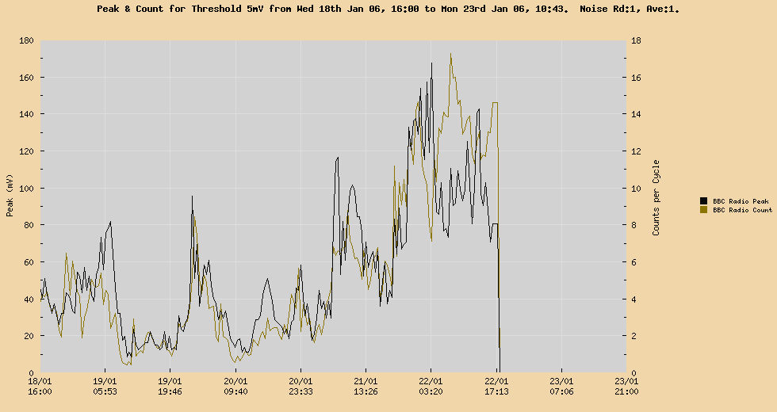
Is PD a useful condition monitoring tool?
Joint
failure
[After: Matthiew, M: Innovative asset management and targeted investments using on-line partial discharge monitoring and mapping techniques, CIRED, Vienna, 2007]

Slide 8
Electromagnetic PD detection methods
Electrical contact
Near-field coupling
Internal UHF
Free-space radiometric

Slide 9
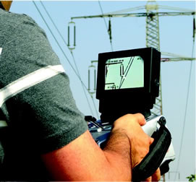
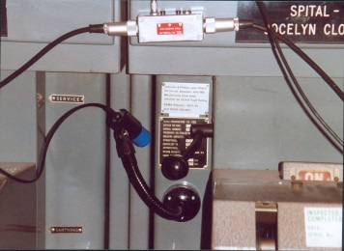
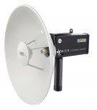
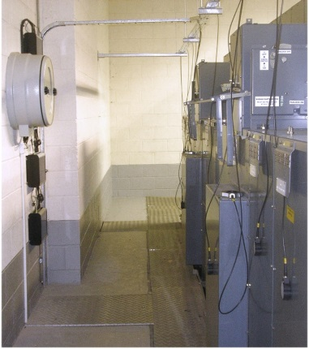
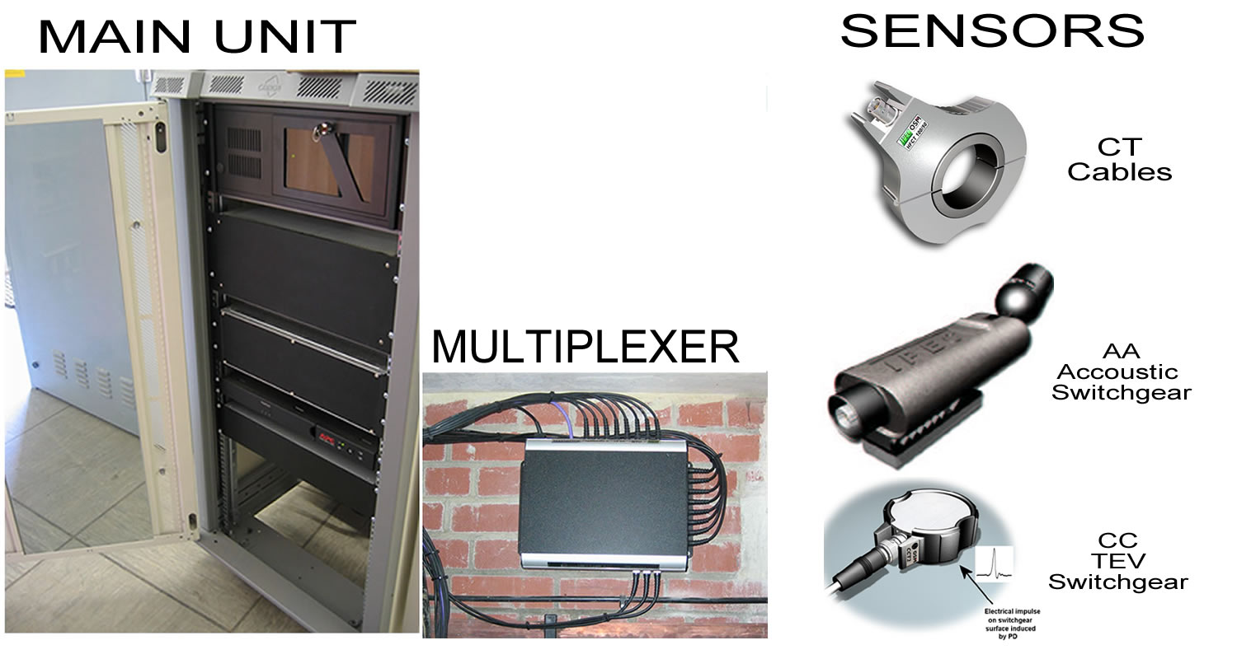
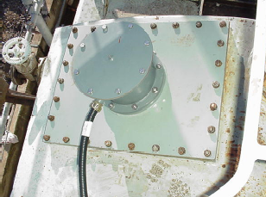
PD sensors
Acoustic and ultrasonic
Light and UV - especially corona
Thermal (IR) - cable terminations and switchgear
Electromagnetic
  Direct contact methods
  HFCTs (individual cables)
  TEVs (local items, e.g. switchgear)
  Radiometric (wide area detection of RFI)
UV/visible imager
Ultrasonic fixed sensor
Ultrasonic free-space
LOS sensor
HFCT sensor
TEVs deployed on air-insulated switchgear
Acoustic sensor
TEV sensor
Ultrasonic/RF

Slide 10
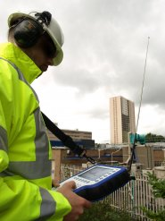
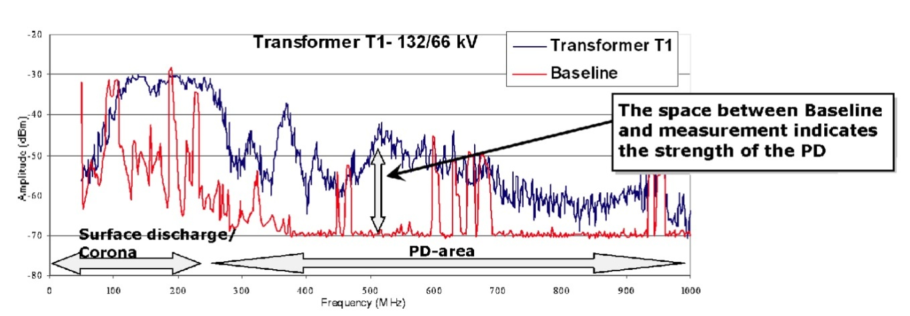
Radiometric detection
E.g. RFI surveying tool (PDS100)
Essentially an elementary spectrum analyser
50 MHz – 1 GHz
1 – 2 times per year typically in UK
[After:http://www.doble-lemke.eu/en/Products/Partial_Discharge/PDS_100.html]

Slide 11
Free-space radiometric location methods
Time-difference-of-arrival (TDOA)
Radiometric intensity

Slide 12
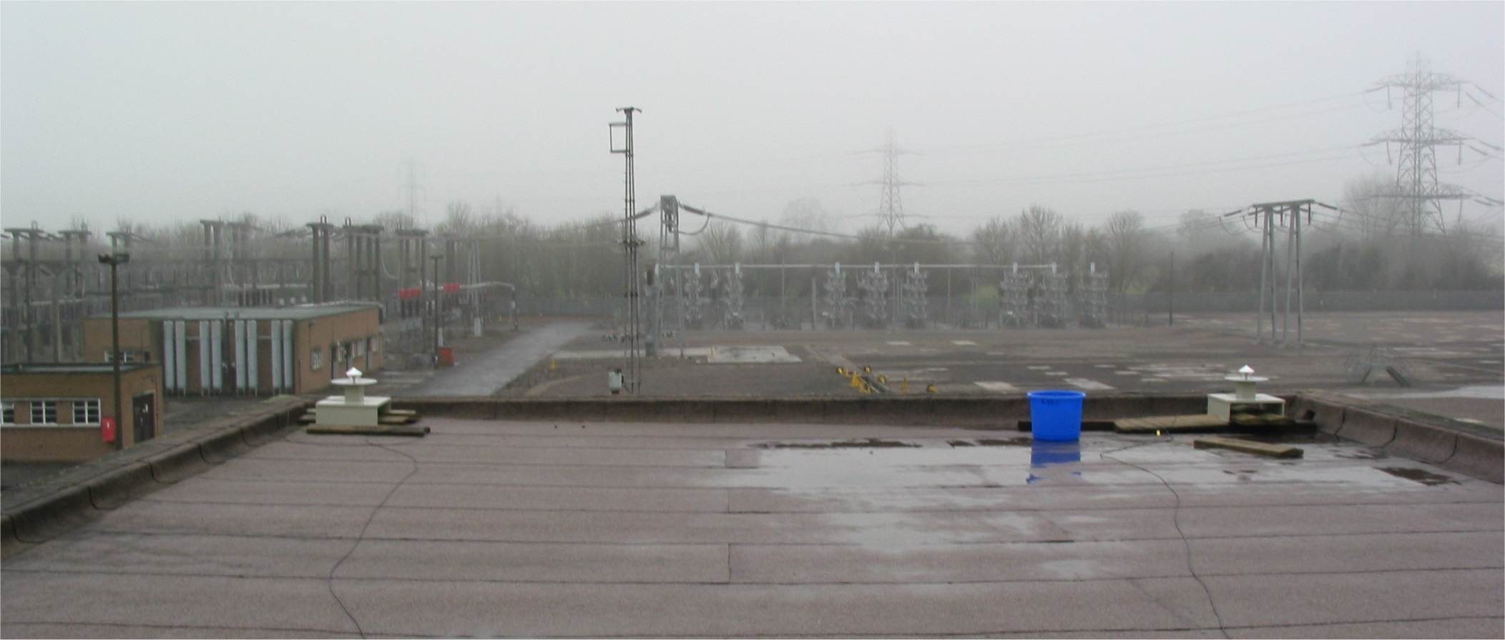
Time-difference-of-arrival (TDOA) PD location
Substation control-room roof looking west
(two antennas behind camera)
Approximate position of 132 kV current transformer
Antennas

Slide 13
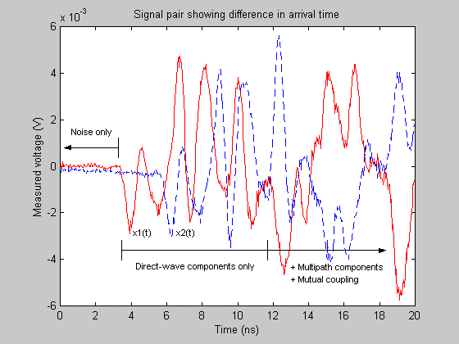
Oscilloscope traces TDOA location

Slide 14

TDOA location of enhanced PD
1000
Antennas
1100
Locus of increasingly strong PD events
1200
1300
1400
1500
1600
1700
1800
1900
400
500
600
700
800
900
1000
1100
1200
1300

Slide 15
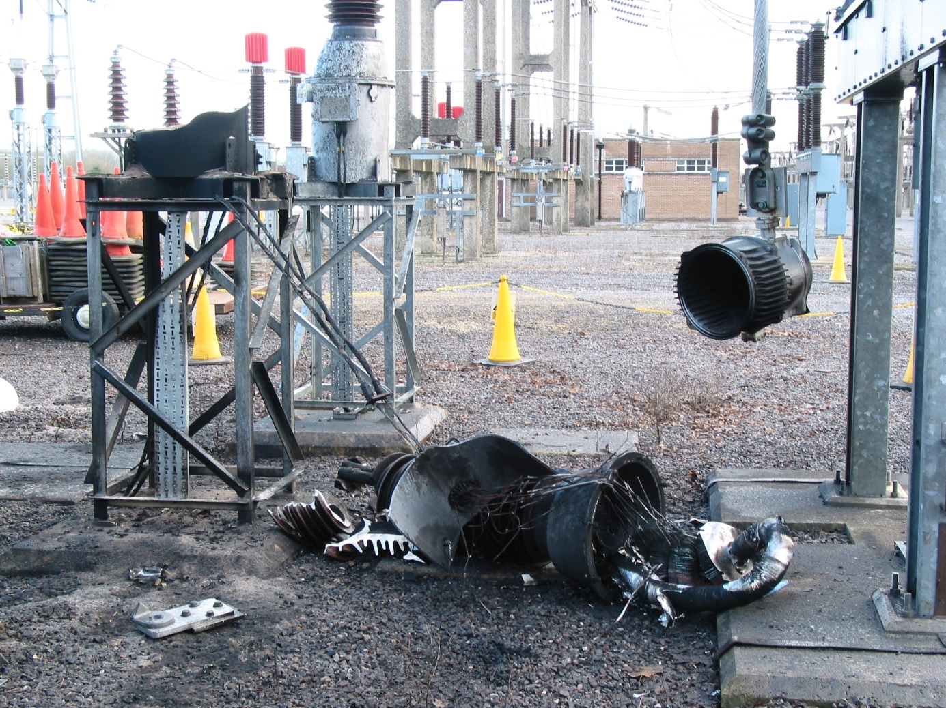
Failed current transformer

Slide 16
Effectiveness of TDOA radiometric location
1000
Antennas
1100
Locus of increasingly strong PD events
1200
1300
1400
Bay containing failed CT
1500
1600
1700
1800
1900
400
500
600
700
800
900
1000
1100
1200
1300

Slide 17
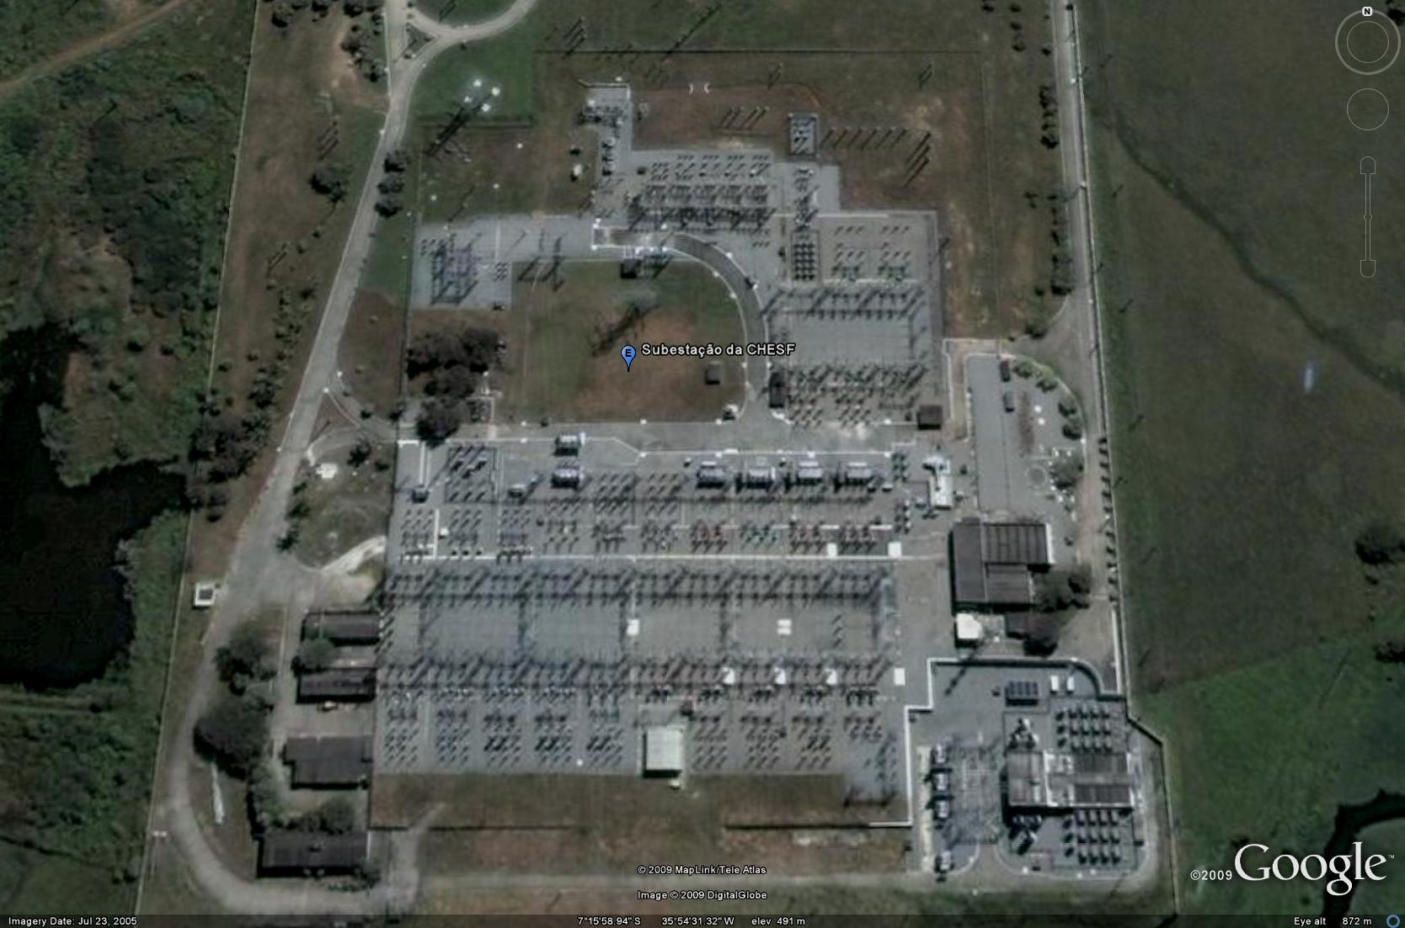
Free-space radiometric intensity location
PD intensity measurements
Source location
  path-loss law inversion
  pattern matching

Slide 18
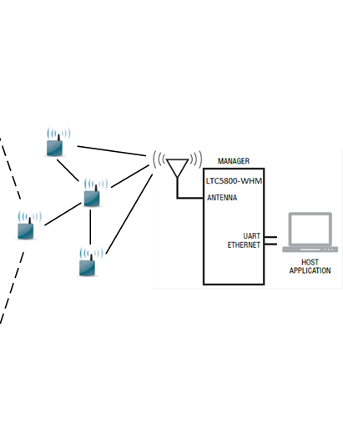
Proposed Wireless Sensor Node

Slide 19
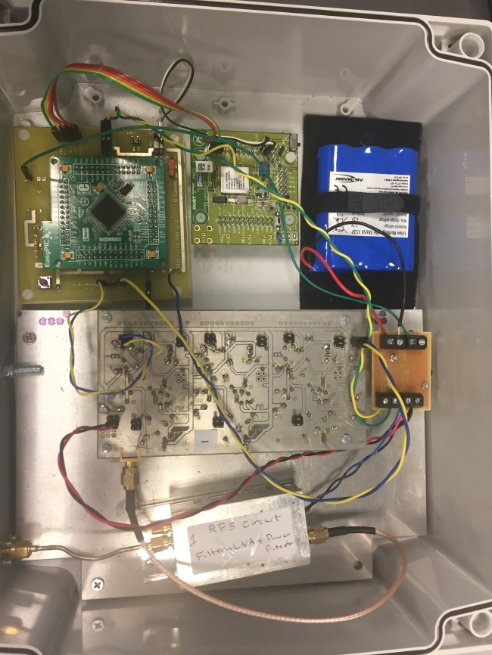
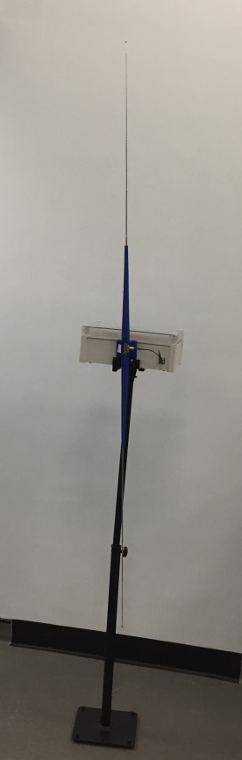
Sensor Node Prototype

Slide 20
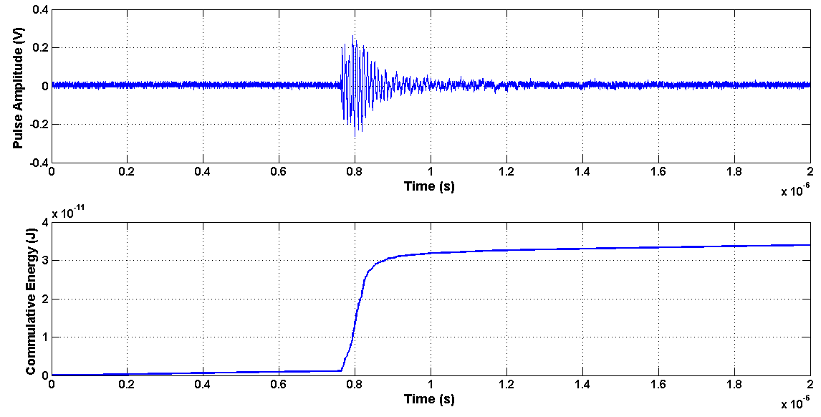
PD signal and energy
Received RF signal
Cumulative energy

Slide 21
RF sampling versus envelope detection
RF signal requires high sampling rate
Envelope detected signal requires lower sampling rate and therefore reduced energy from power supply
Longer battery life for the WSN nodes and/or cheaper energy harvesting technologies

Slide 22
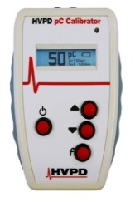
Sensor Node Calibration
An HVPD pC (picocoulomb) charge-injection pulse generator.
The device provides pulses from 1 pC to 100 nC (100,000 pC) with selectable pulse repetition rate (100, 120, 400 Hz).

Slide 23
Indoor test-sports hall
Carried out at a sports hall, University of Huddersfield.
PD WSN layout
Photograph of the test space.

Slide 24
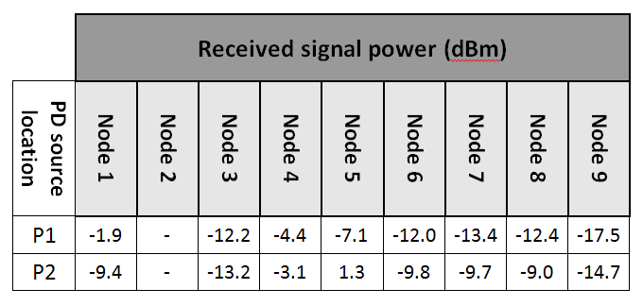
Received signal power by nodes

Slide 25
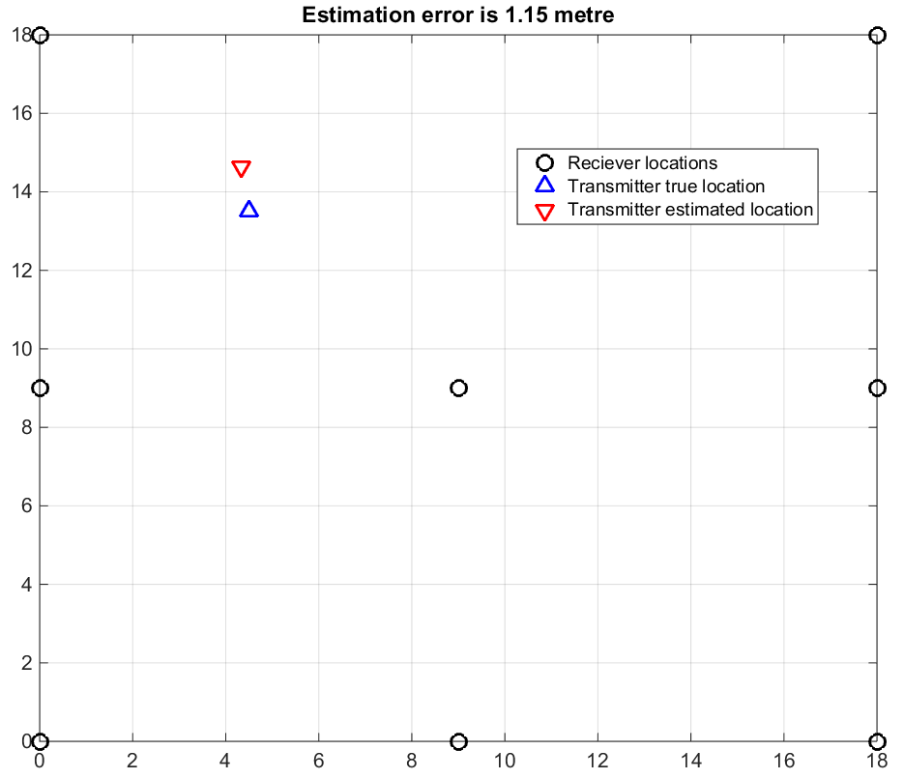
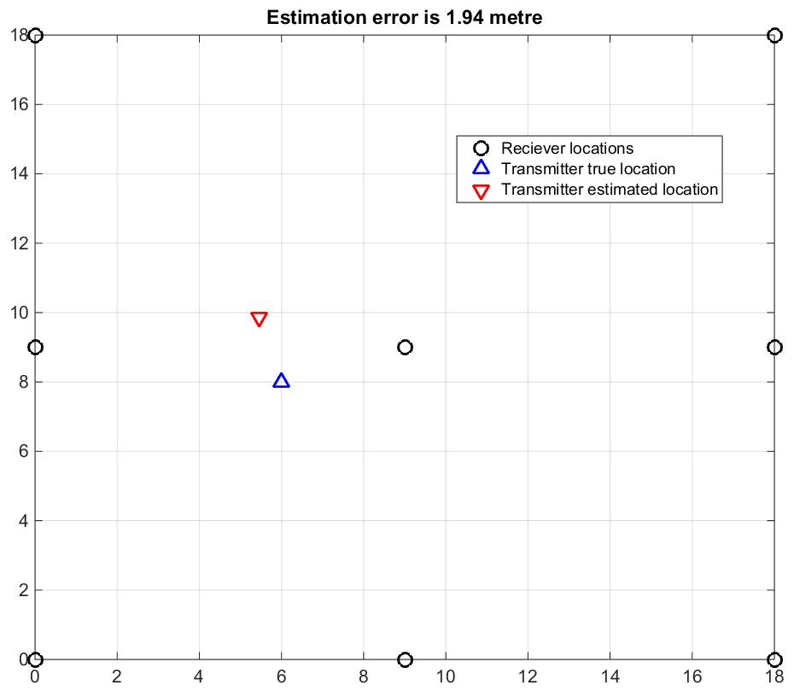
Estimated location of the PD source
PD source localisation is based on using a location algorithm that relies on received signal strength (RSS).
Position 1
Position 2

Slide 26
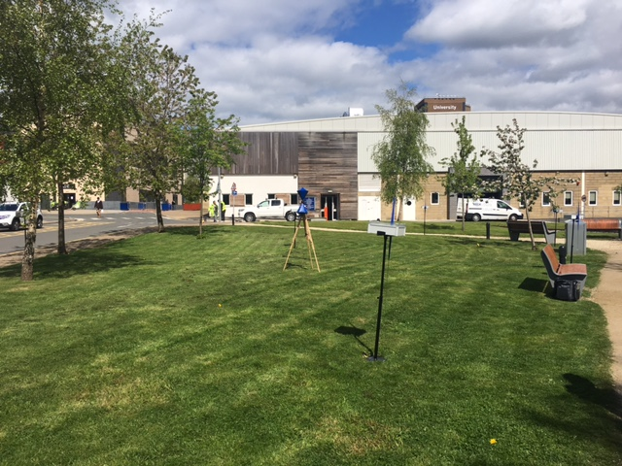
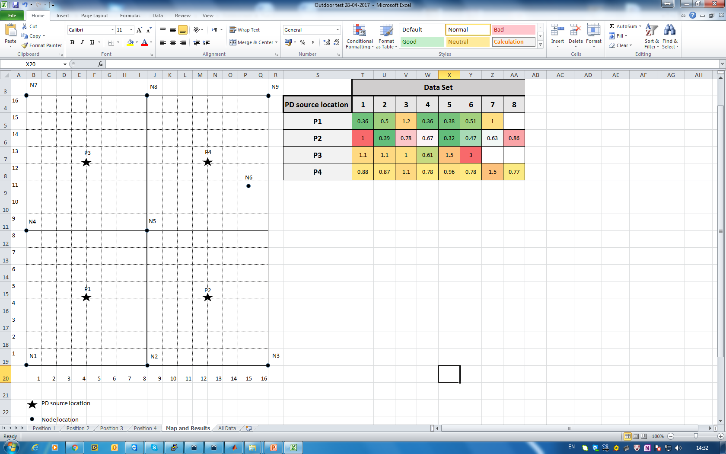
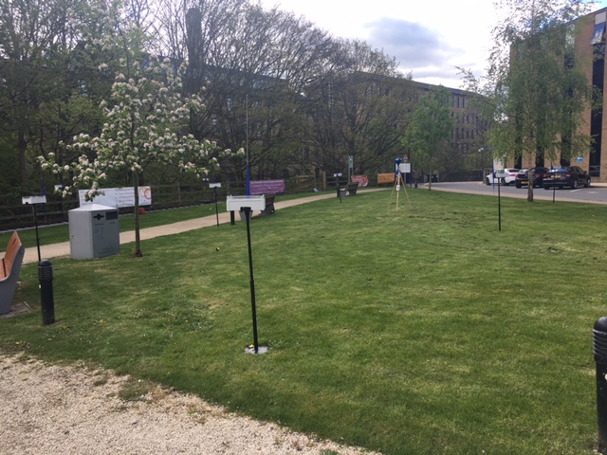
Outdoor test-Campus
Carried out at University of Huddersfield.
PD WSN layout
Photograph of the test space.

Slide 27
Estimated location of the PD source
PD source location | Estimated location error (m)
P1 | 0.36
P2 | 1
P3 | 1.1
P4 | 0.88

Slide 28

Field test-PNDC Glasgow
A system of 10 nodes was deployed in July 2017 in a more realistic environment.
Power Networks Demonstration Centre, Cumbernauld, Glasgow

Slide 29

Field test-Tata Steel, Port Talbot
A system of 10 nodes was deployed successfully in Tata Steel, switchgear room (Oct. 2017- Apr. 2018).

Slide 30
Challenges
Sensor sensitivity
  multiple nodes to receive PD for location algorithm to be effective
  distance between nodes >10 m
Power requirements
  Battery life >12 months
  Energy harvesting
Cost

Slide 31
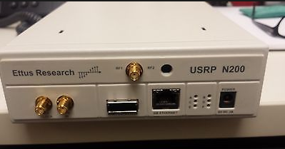
PD detection with SDR
To use a low-cost, Software Defined Radio (SDR) technology configured as a spectrum analyser to measure the radio power spectral density across the PD frequency band.

Slide 32
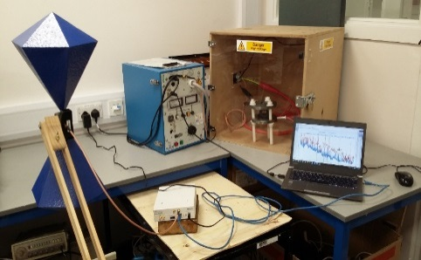
SDR applications
Application | Frequency range
FM Radio | (88- 108)MHz
Aeronautical | (108-117)MHz
Meteorological | 117MHz
Fixed Mobile | (140-150)MHz
Special events broadcast | (174-217)MHz
ISM band(short range) | -433 MHz
Emergency services | (450-470)MHz
UHF TV broadcast | (470-790)MHz
4G LTE Advanced | 800 MHz bands
SDR/loT | (863-870)MHz
GSM-R band (UK) | (921-925)MHz
GPS System | 1227 MHz/1575 MHz
PD Detection | (50-800)MHz
From
DC to 6 GHz

Slide 33

The experimental set-up for
PD detection - indoor
High Voltage power supply applied to the PD emulator which is responsible to generate PD signal and SDR connected to the laptop to capture the PD signal and analyse it.
The experimental set-up (indoor)

Slide 34
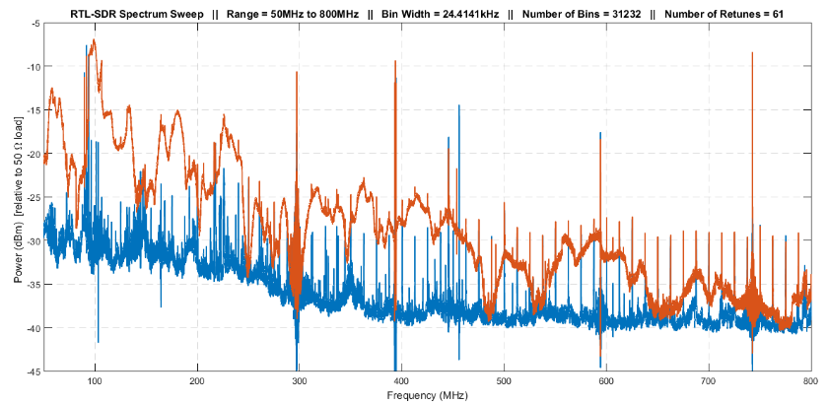
Experimental results (indoor)
PD signal measured spectrum using USRP N200 transceiver

Slide 35
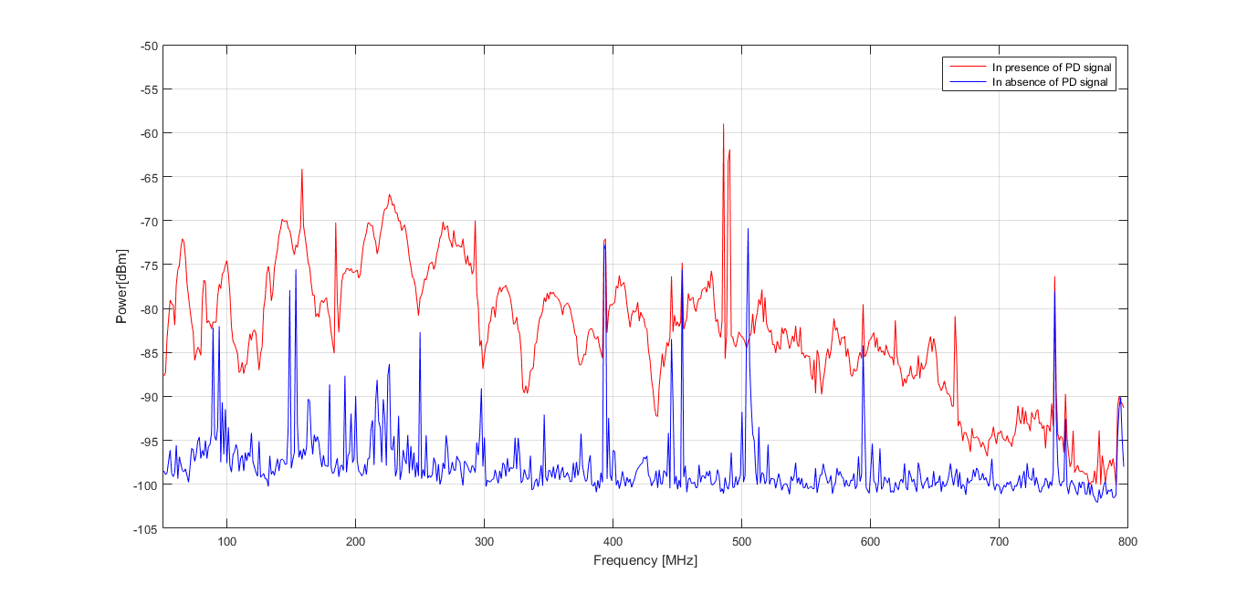
Experimental results (indoor)
PD signal measured spectrum using Spectrum analyzer.

Slide 36
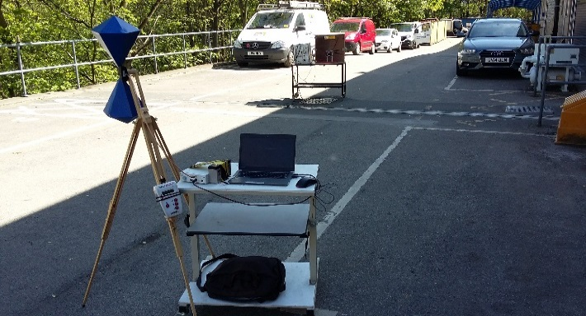
The experimental set-up
for PD detection - outdoor
A PD emulator (used as PD source).
USRP N200
A wideband biconical antenna
A laptop.
Experimental setup

Slide 37
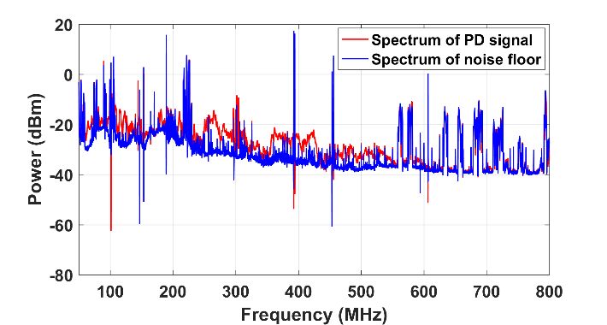
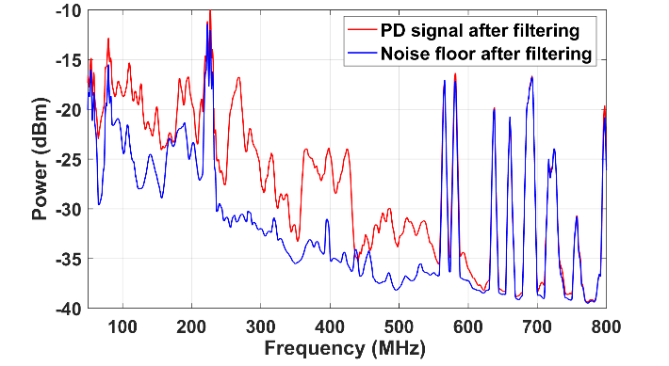
SDR
The measured spectra using a USRP transceiver
PD signal and noise floor after filtering(outdoor).

Slide 38
Conclusion
Intensity-only measurements to locate a PD source was demonstrated
A real-time radiometric WSN system for monitoring and locating PD source has been designed, implemented and tested in indoor and outdoor environment.
RSS-based location algorithm has been demonstrated to successfully locate an emulated source of PD with useful accuracy.
SDR approach to the measurement/monitoring/location of PD can be an alternative to traditional detection methods.
Results sufficiently encouraging for continued work.

Slide 39
The authors acknowledge the support of the U.K. Engineering and Physical Sciences Research Council under Grant EP/J015873
End

